Slide 1
12A-2

Slide 2
SEM minerals
Plagioclase, quartz, K-feldspar, muscovite, biotite, titanite, apatite, zircon, iron oxide, ilmenite, monazite, scheelite, sphalerite

Slide 3
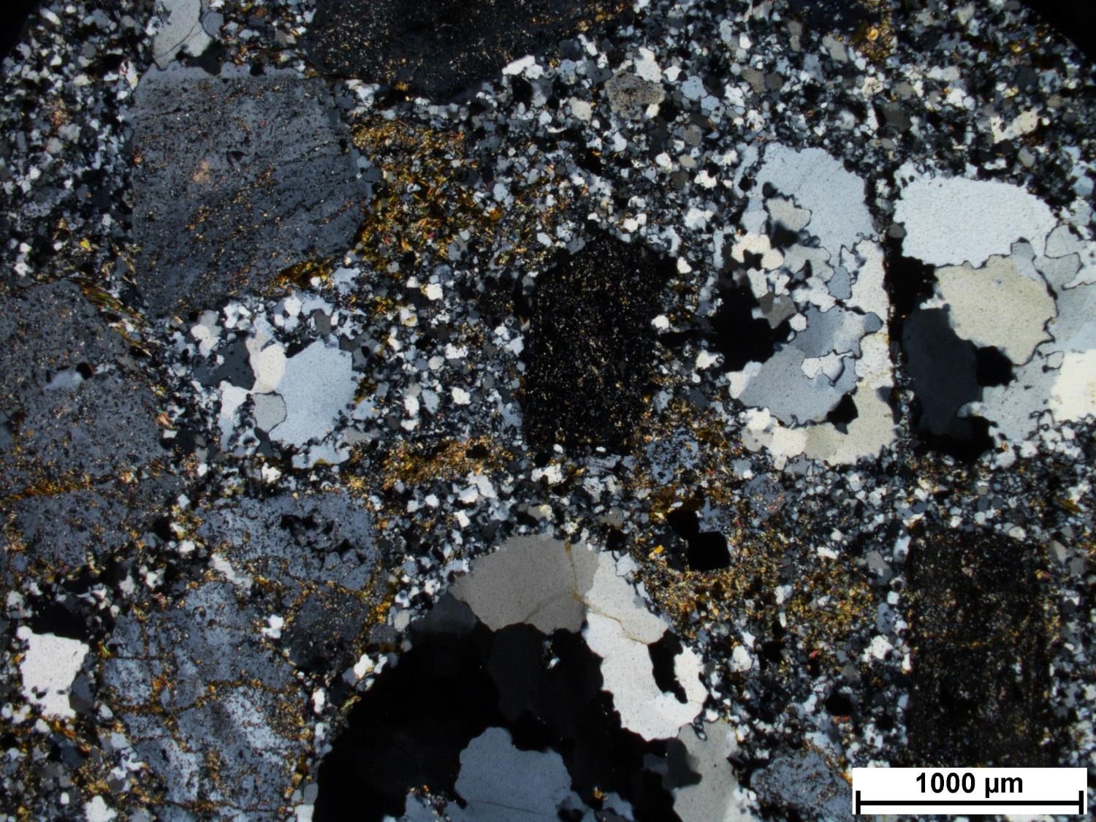
12A-2
Notes:
Replaced groundmass
Shallow intrusive (sub-volcanic) protolith. Porphyritic rock, silicified. Sericite alteration.
Quartz replaced tabular and bipyramidal phenocrysts (K-feldspar?)
Mainly white mica replacing feldspar
Pyrite associated with biotite alteration
White mica with fine grained quartz that is replacing the groundmass.
Secondary pyrite in feldspar, white mica aligned to fluid flow
WM filling cracks, mantling

Slide 4
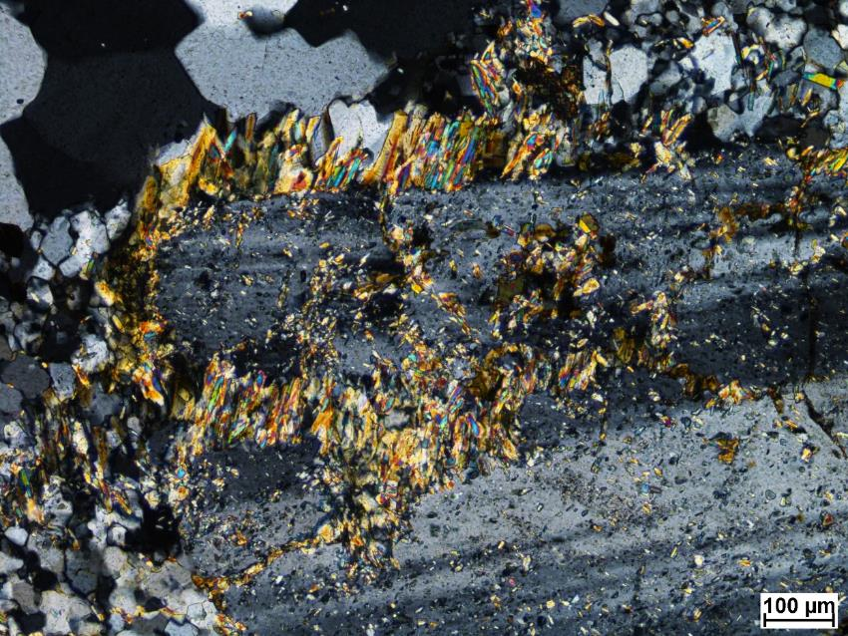
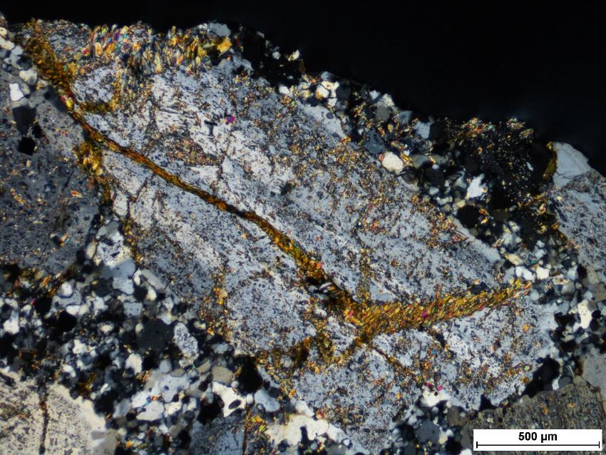

Slide 5
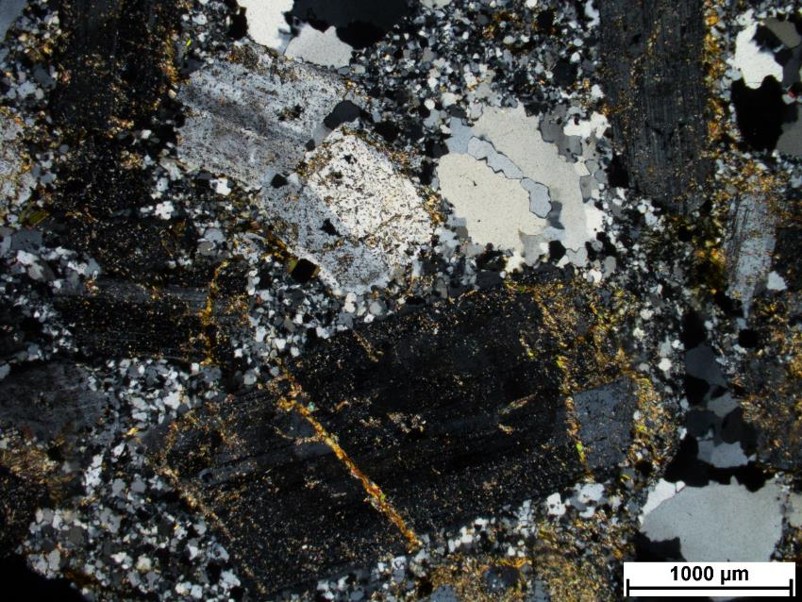
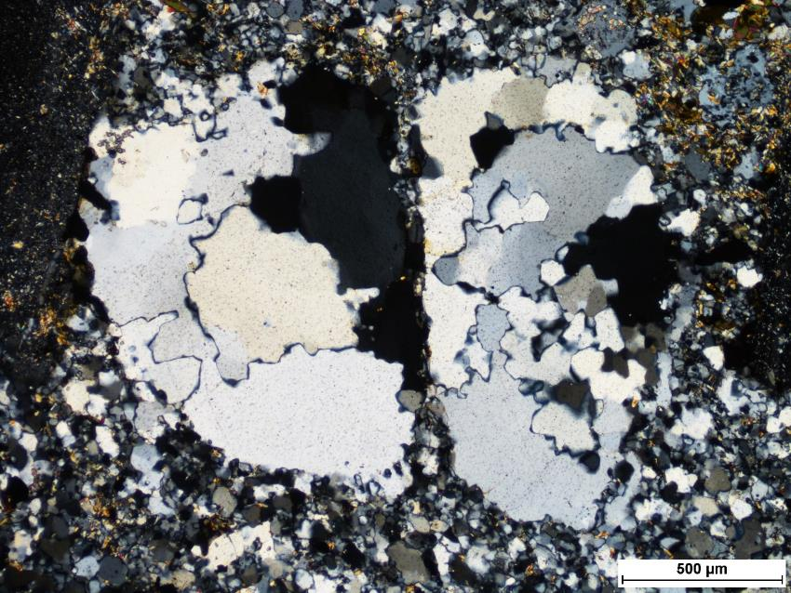

Slide 6
Scheelite
Pyrite

Slide 7
12A-4

Slide 8
SEM minerals
Plagioclase, K-feldspar, biotite, chlorite, titanite, apatite, epidote, zircon, pyrite

Slide 9
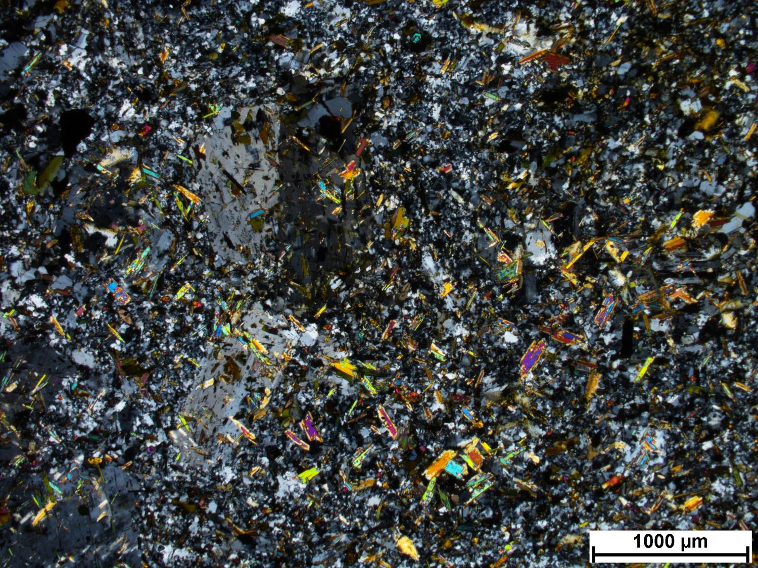
12A-4
Notes:
Porphyritic, highly altered
Zoned zircons
Magmatic biotite preserved (as opposed to shredded, hydrothermal Bt)
Less altered than 12A-2, less quartz in groundmass
Bt core is darker. Alteration consistent with CM (WM and lighter biotite on darker Bt). More distal alteration, less intensive, lots of texture preserved.
WM alteration of feldspar
Pyrite associated with very fine qtz alteration, qtz aggregate

Slide 10
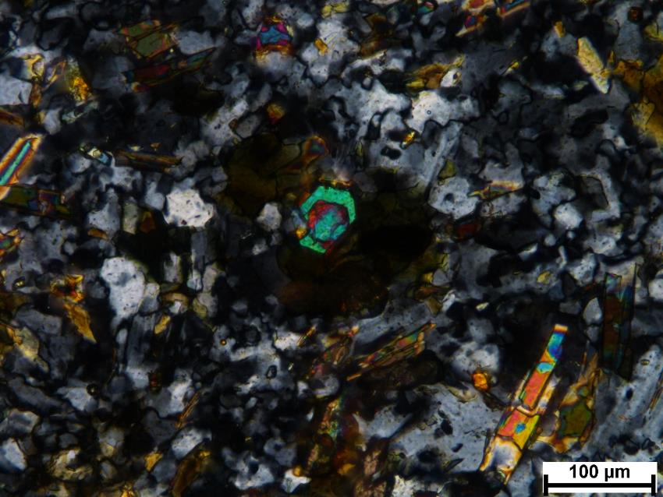
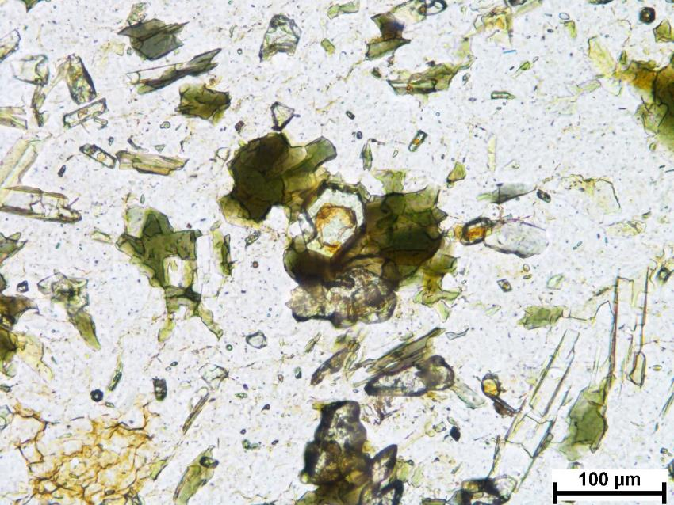

Slide 11
36A-2

Slide 12
SEM minerals
Plagioclase, quartz, muscovite, biotite, chlorite, zircon, iron oxide, chalcopyrite

Slide 13
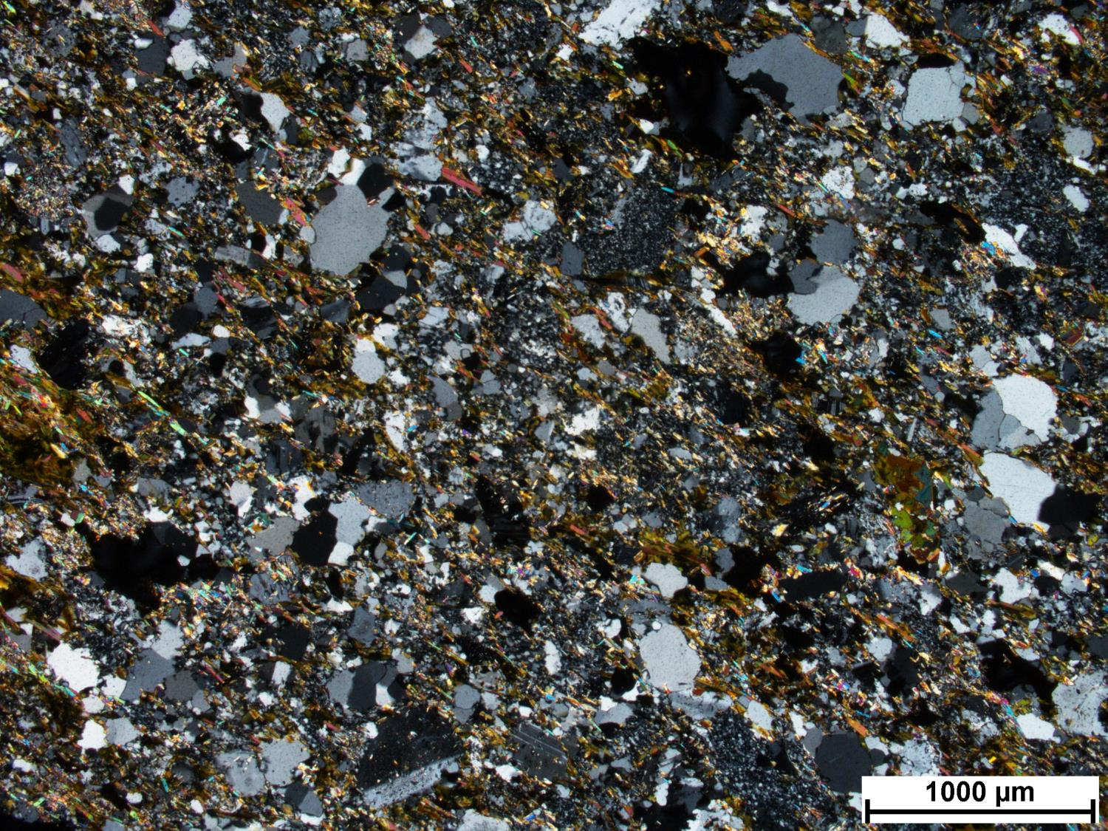
36A-2
Notes:
Quartz replacing phenocrysts
Porphyritic intrusive rock, very silicified
K-spar
Qtz ribbons
Lots of WM replacing feldspar, feldspar was more potassic
Fine-grained WM in groundmass
Less rutile than in other rocks, therefore less Ti. Rutile included in Bt
Crystals replaced by hydrothermal biotite inside, qtz on margins
Magmatic biotite replaced by hydrothermal Bt. Two generations, corroded contact (not sharp). Composition seems similar in terms on Fe content because we don’t see difference in colour
WM later, replaces both Bt generations
Bt looks too dark to be phogopitic

Slide 14
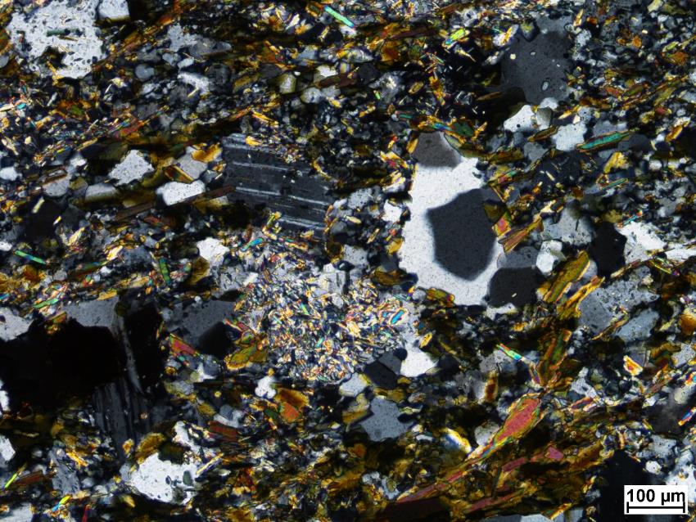
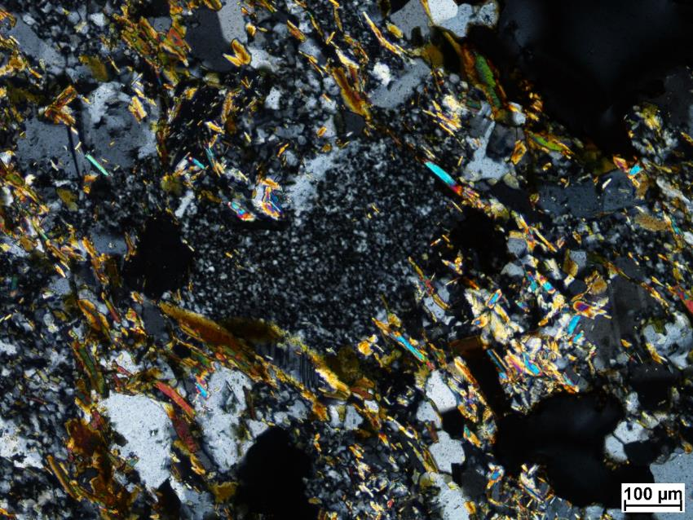

Slide 15
36A-3

Slide 16
SEM minerals
quartz, K-feldspar, muscovite, biotite, apatite, zircon, ilmenite

Slide 17
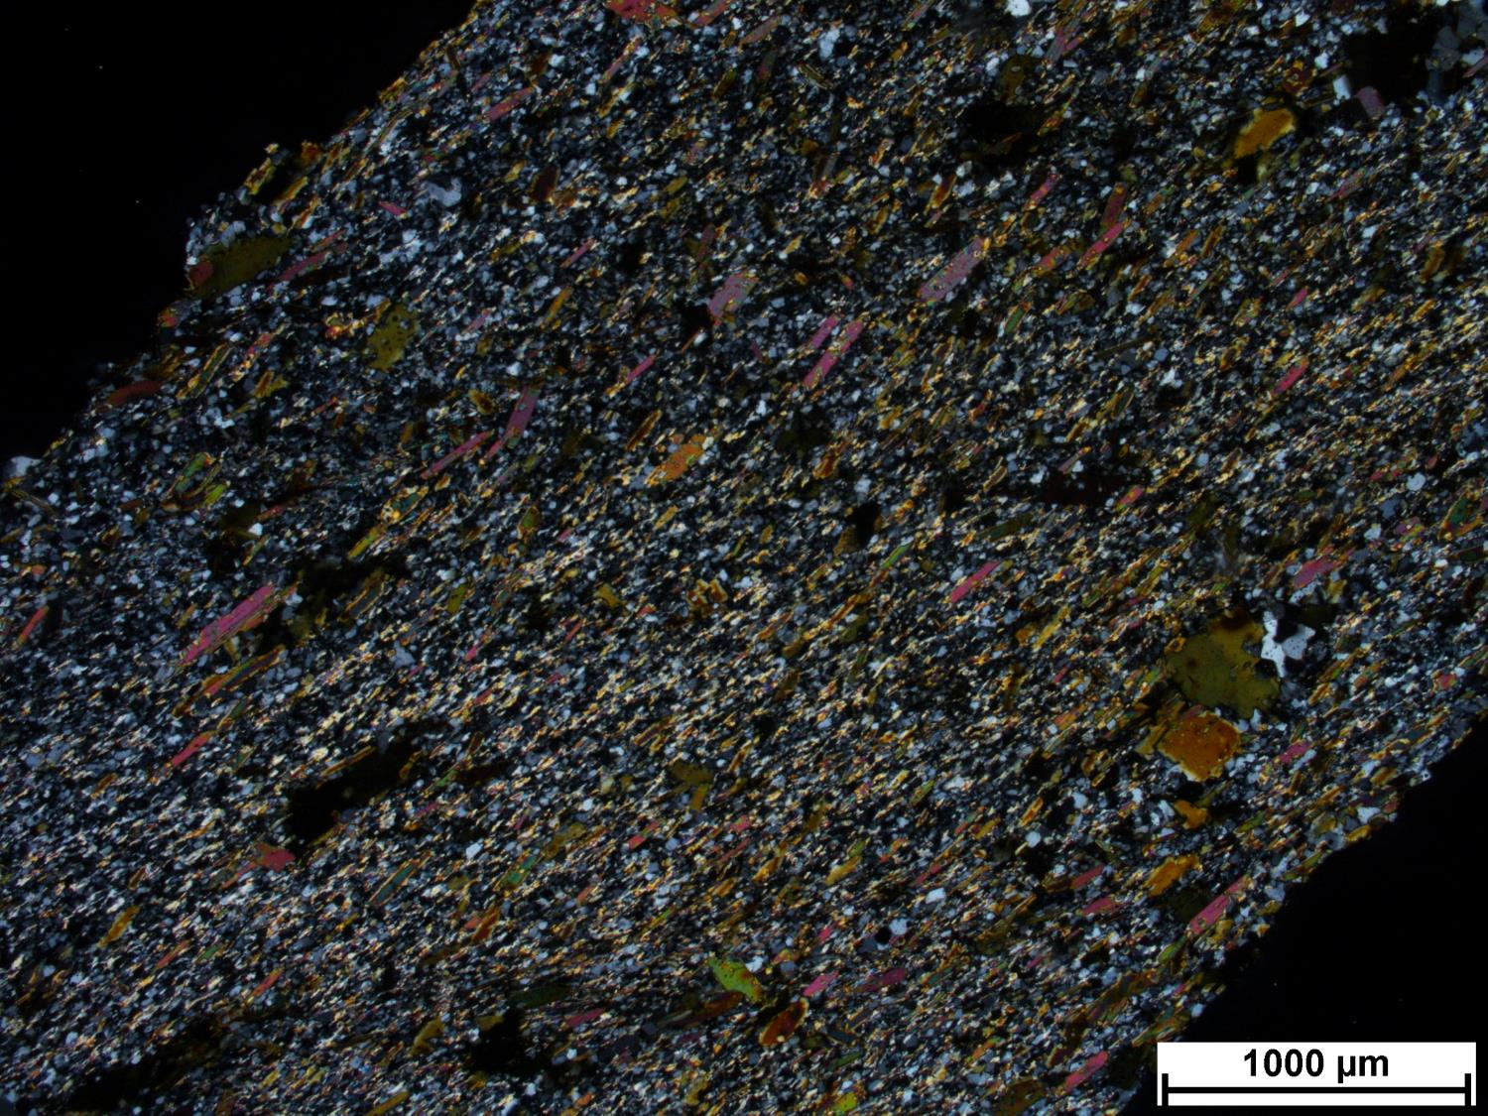
36A-3
Notes:
Bt foliation
More like CM, same thermal regime as northern part of Cm, more biotite, don’t see as much chlorite. Siltstone protolith? Compatible with CM
Some grains are located
Fine WM
Pressure shadow qtz behind Bt
Larger Bt may have been earlier, but colours not different
Some Bt altering metamorphic bt (alteration is lighter)

Slide 18
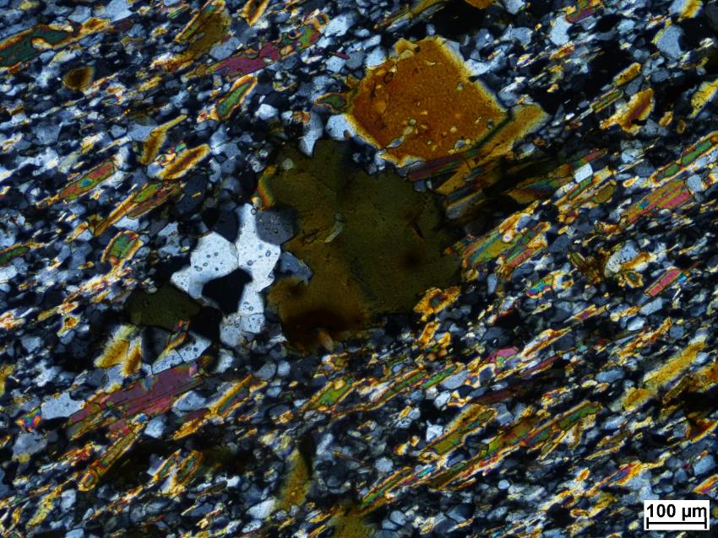
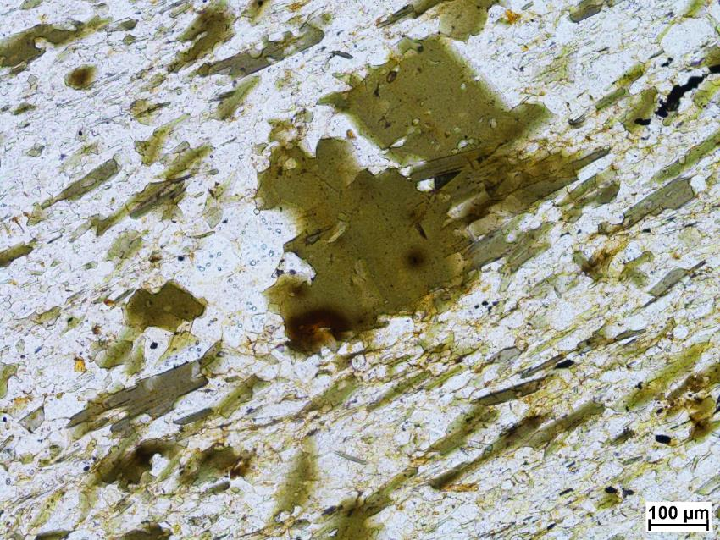

Slide 19
Biotite foliation

Slide 20
36A-4

Slide 21
SEM minerals
Plagioclase, quartz, K-feldspar, biotite, zircon, rutile, pyrite

Slide 22
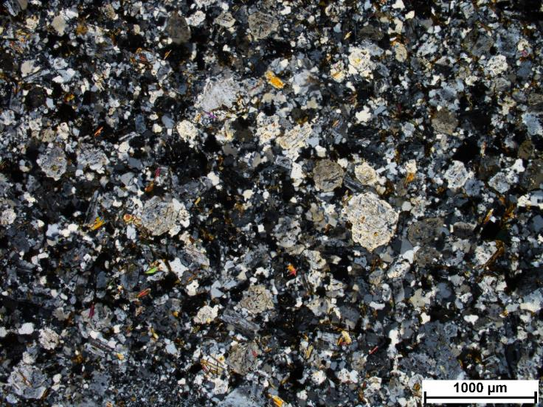
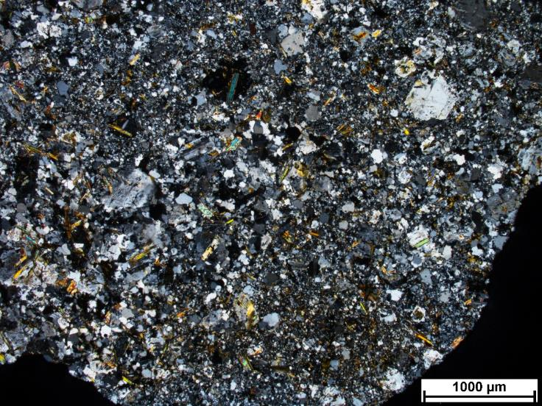
36A-4
Notes:
Plag replaced by silica (finer grained alteration, more intense alteration, silica filling corroded zones in feldspar, hydrothermal qtz. Zone of permeability is more altered
Alteration can be albite or k-feldspar, but looks like qtz
Py associated with Bt. Magmatic biotite with lighter hydrothermal Bt (Fe from magmatic biotite goes to make Py, then hydro Bt is more Mg-rich)
Magmatic bt also replaced by rutile (when not enough to make Py)
Porphyritic, monzonite

Slide 23
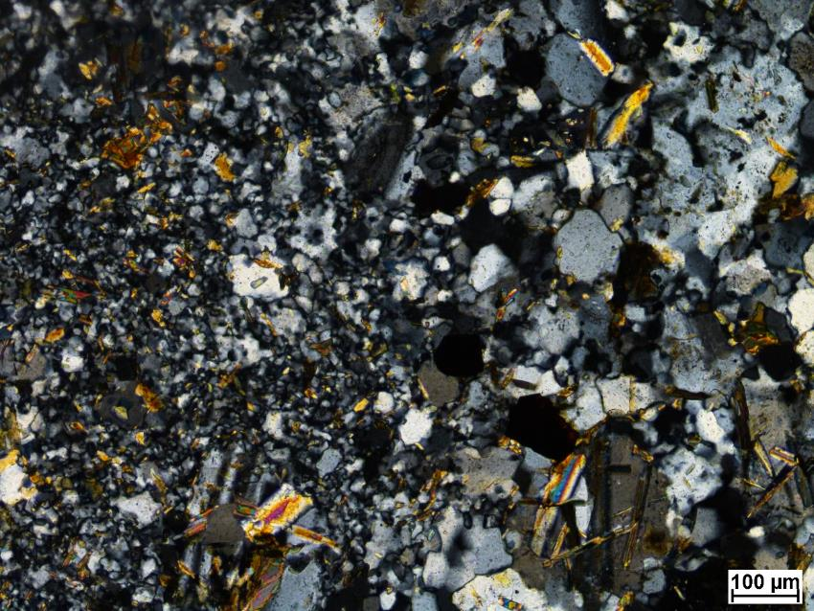
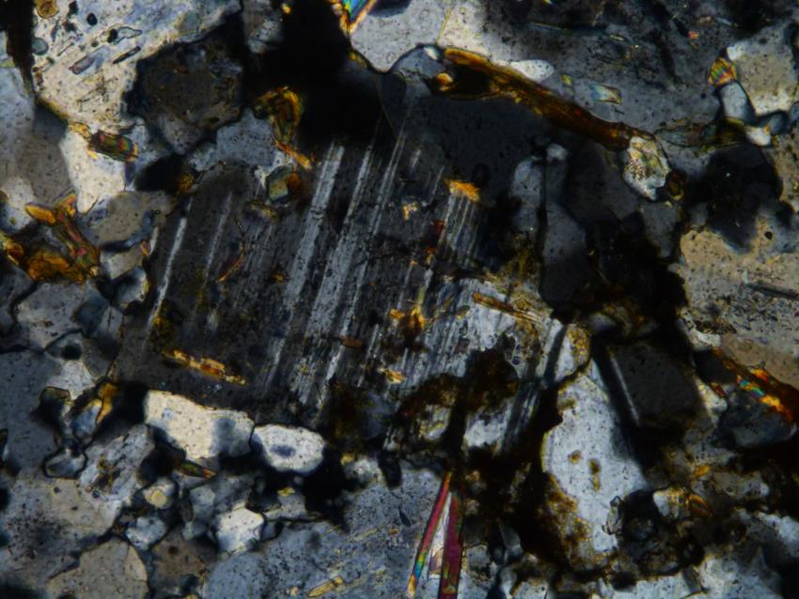

Slide 24
57A-2

Slide 25
SEM minerals
quartz, muscovite, chlorite, titanite, epidote, zircon, rutile, galena

Slide 26
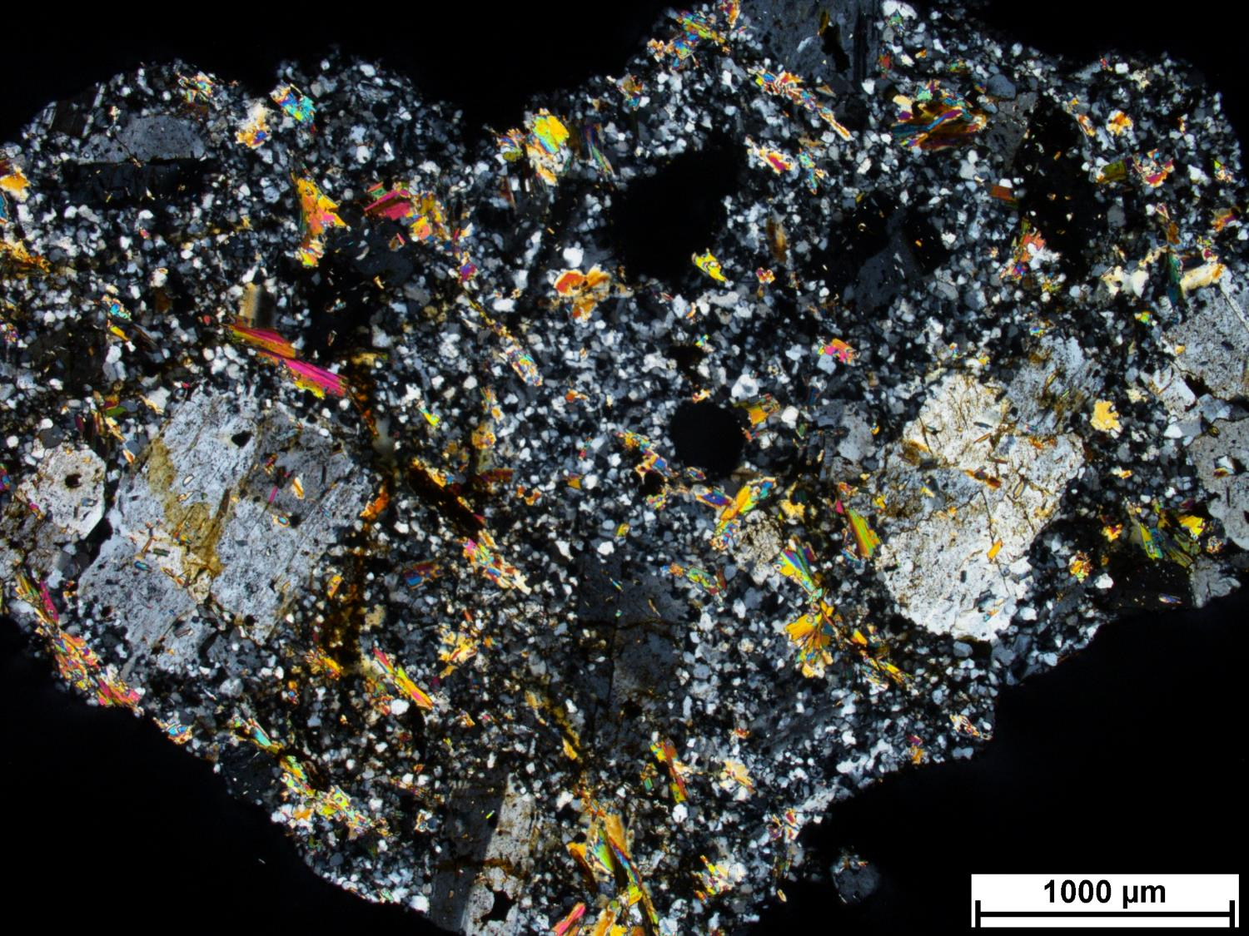
57A-2
Notes:
Intrusive, porphyritic rock, protolith?
Plagioclase with corroded margins, WM alteration
Carlsbad twinning
WM replacing Bt
Consistent with CM
Silicified groundmass, remnant plag
Orthoclase, some plag

Slide 27
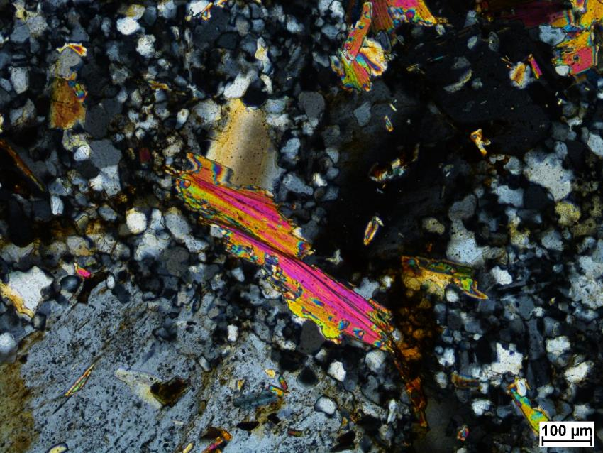
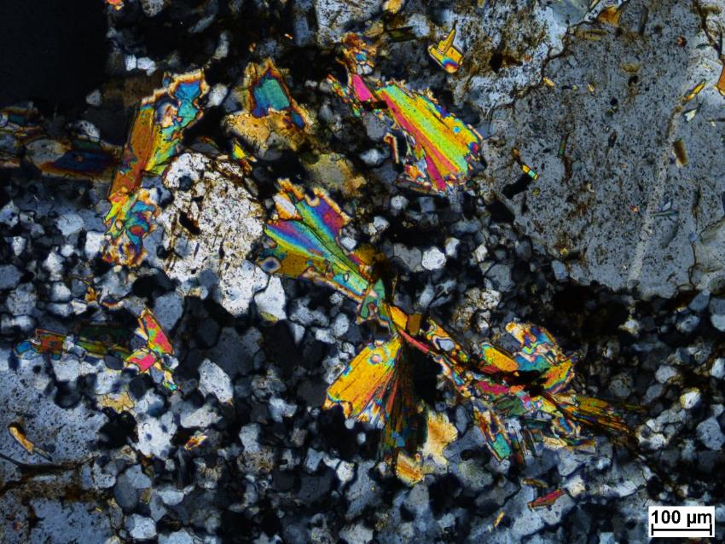

Slide 28
57A-4

Slide 29
SEM minerals
Plagioclase, quartz, K-feldspar, muscovite, titanite, apatite, epidote, zircon, iron oxide, Th-phosphate, rutile

Slide 30
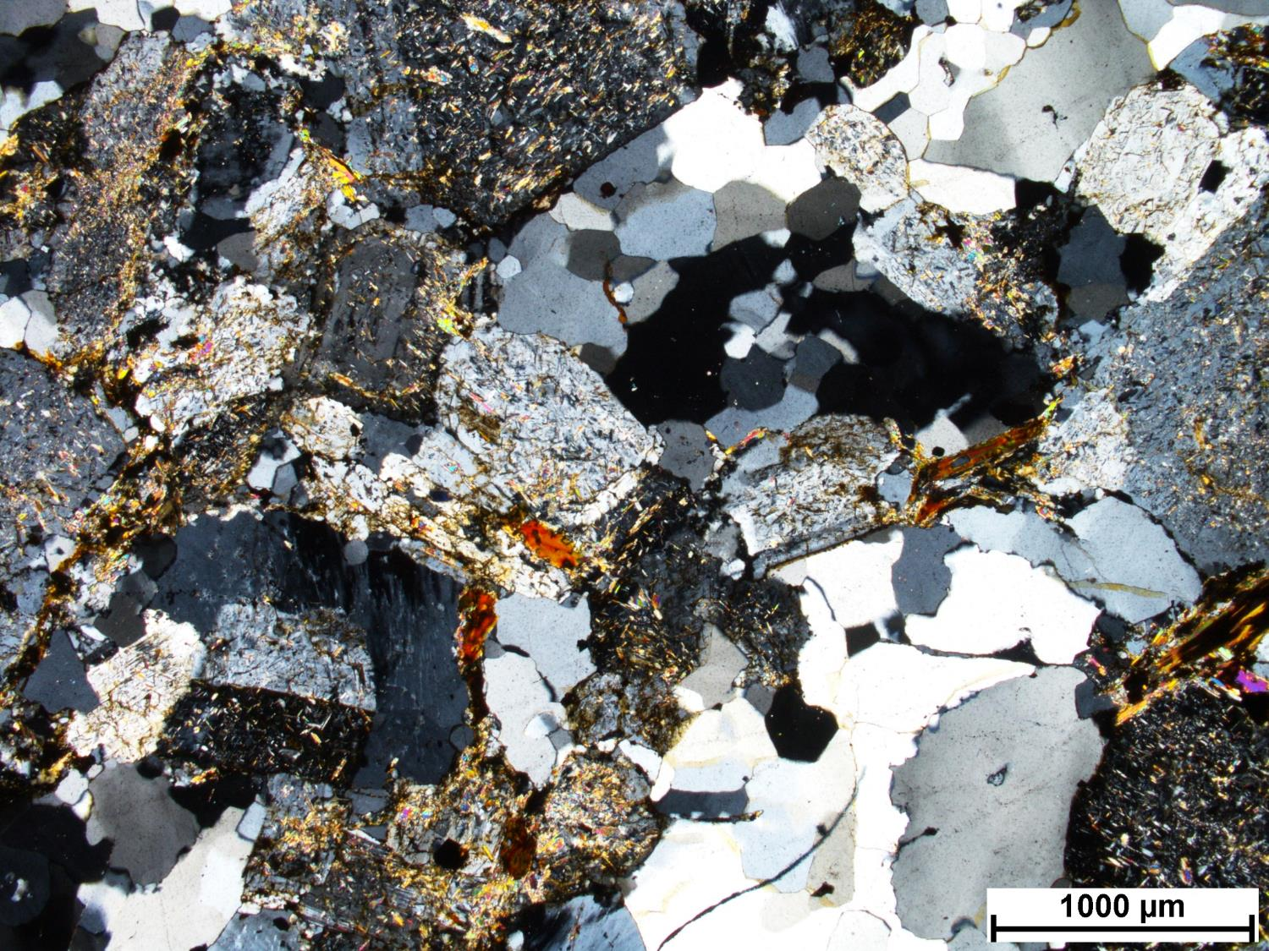
57A-4
Notes:
Intrusive, equigranular
Intense WM, sericite alteration of plagioclase
Feldspar alteration around relict crystals?
Bt altering to rutile, then Bt replaced by WM
Two generations of Bt (older one darker, newer one more phengitic)
Consistent with CM

Slide 31
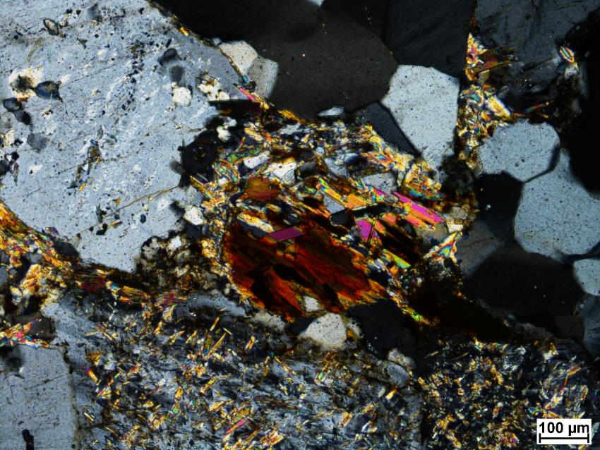
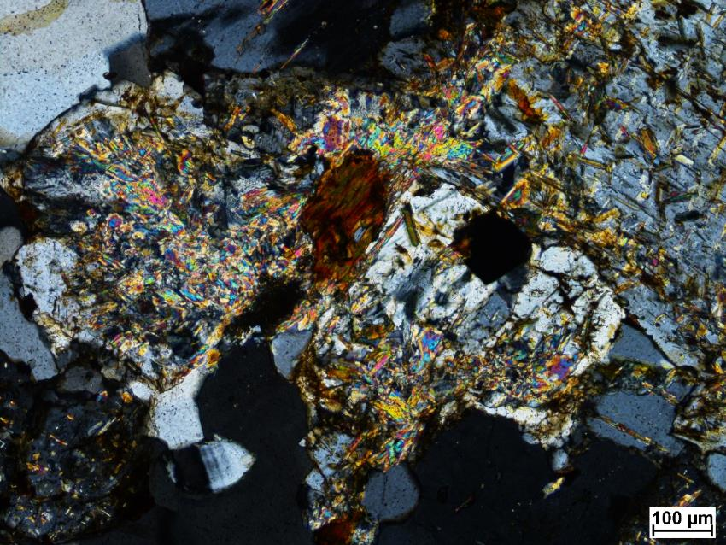

Slide 32
63A-1

Slide 33
SEM minerals
Plagioclase, quartz, K-feldspar, muscovite, titanite, epidote, zircon, rutile, allanite

Slide 34
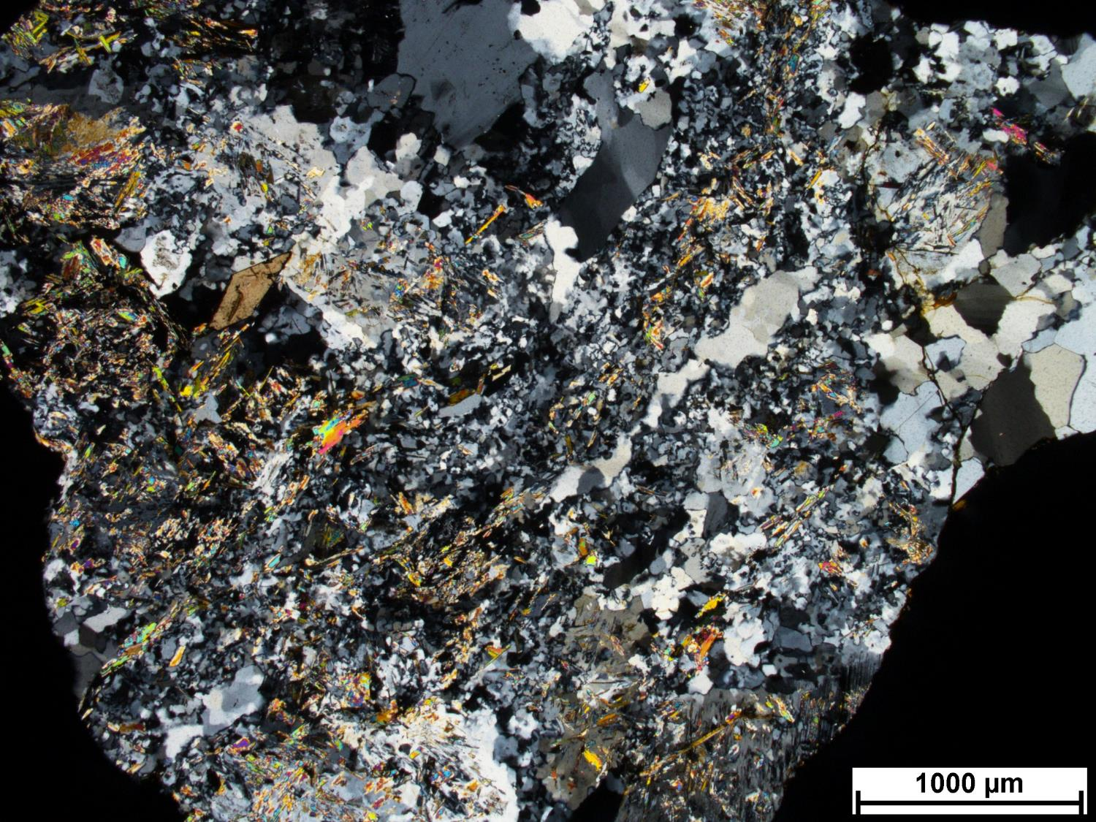
63A-1
Notes:
Lots of silicification, white mica, titanite
Qtz ribbons
Very intense alteration
High strain, regular sutures, subgrains, margin of the vein
Proximal to faulting
Pontiac? If close to fault zone possibly.
Possible alteration of feldspar.
SEM check radial minerals: muscovite with Ba?

Slide 35
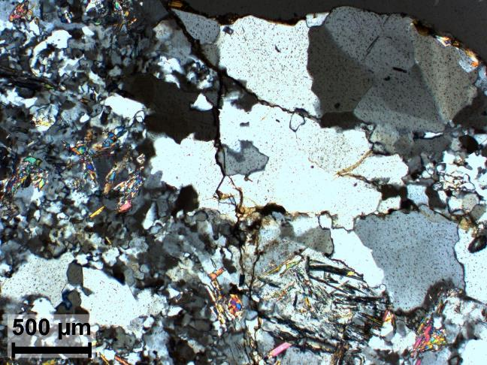
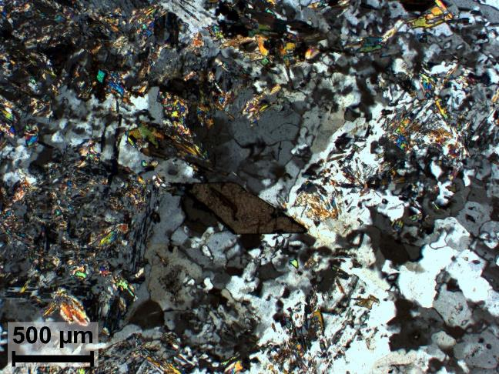

Slide 36
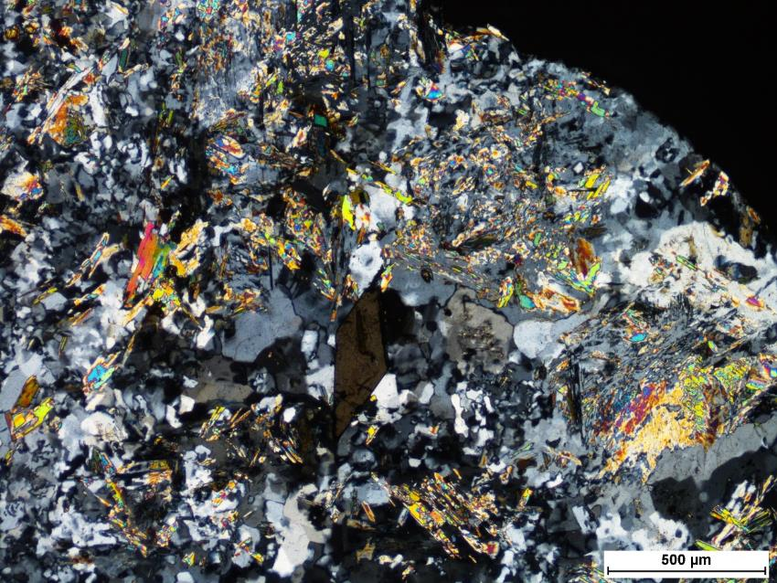
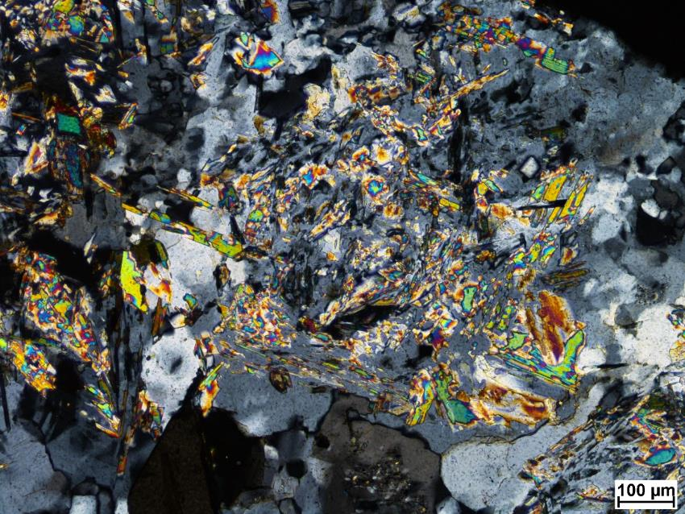

Slide 37
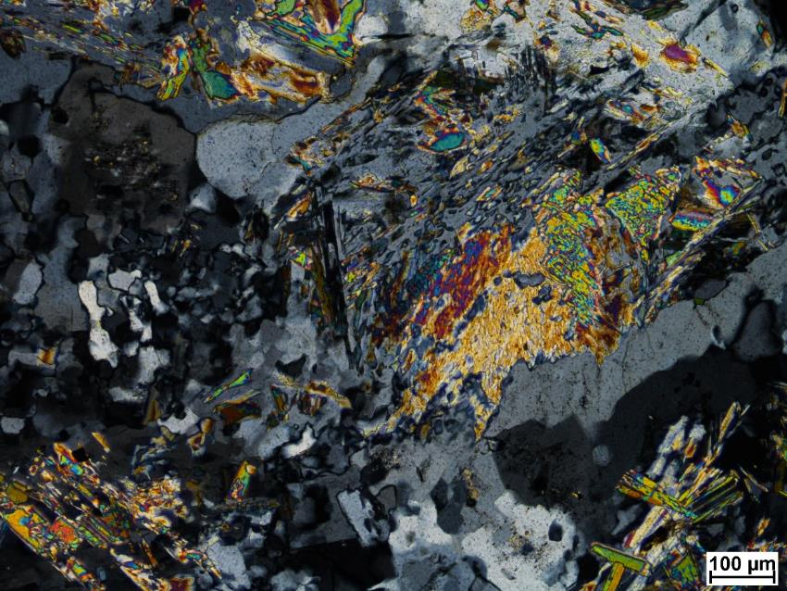
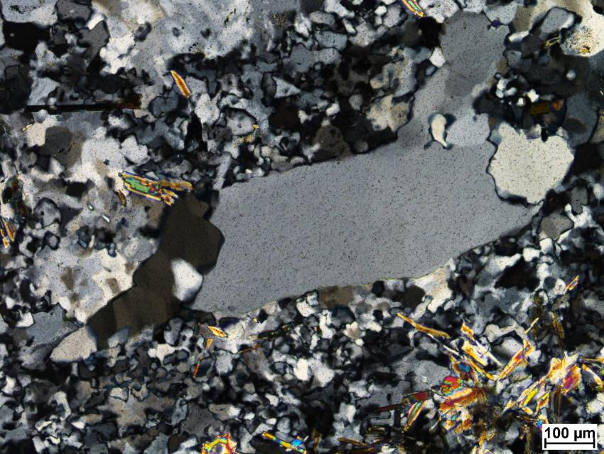

Slide 38
SS1-2

Slide 39
SEM minerals
Plagioclase, quartz, K-feldspar, muscovite, apatite, zircon, iron oxide, rutile, pyrite

Slide 40
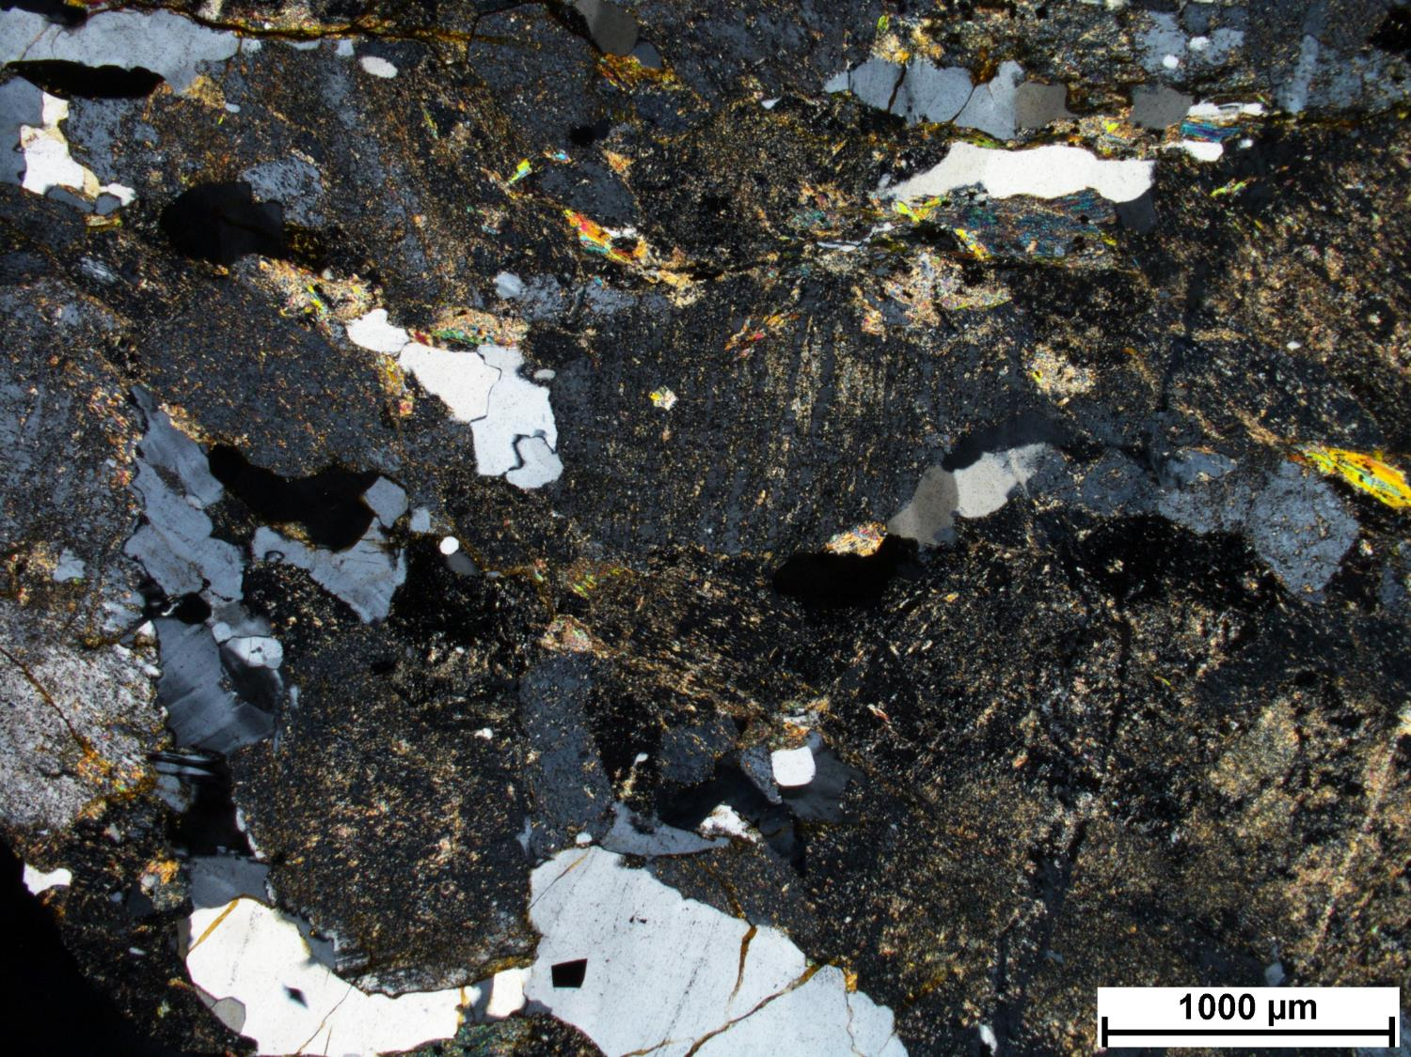
SS1-2
Notes:
Lower temperature hydrothermal K-feldspar replacing plagioclase crystals (similar to more proximal alteration at CM) and silicification. Embayed boundaries for plag.
Very intensely altered plag, high temperature fine grained white mica.
Parent: Intrusive rock, plag rich (monzonite, monzo-diorite?)

Slide 41
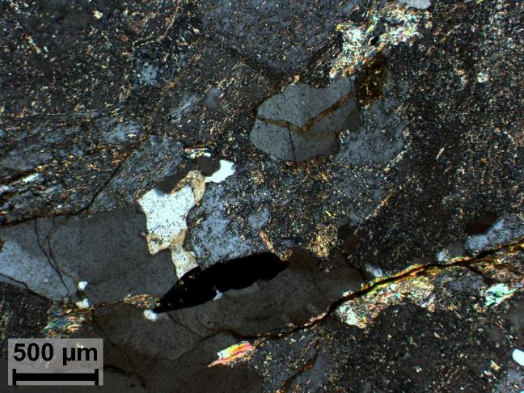
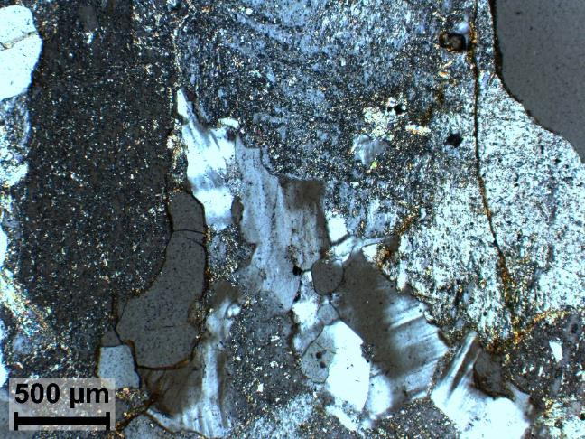

Slide 42
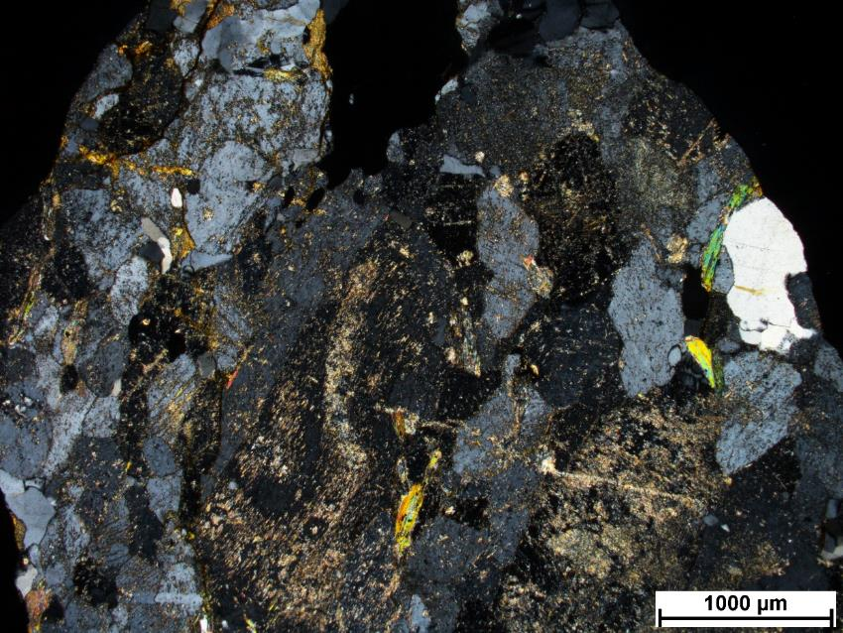
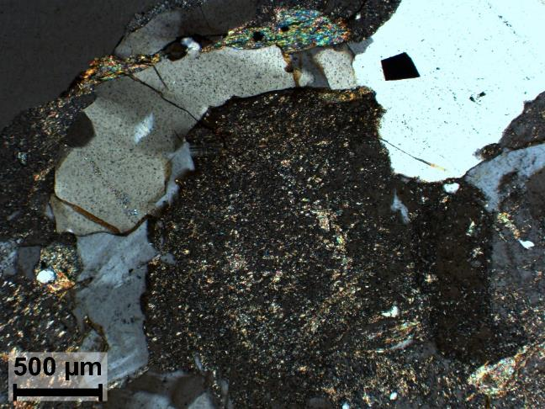

Slide 43
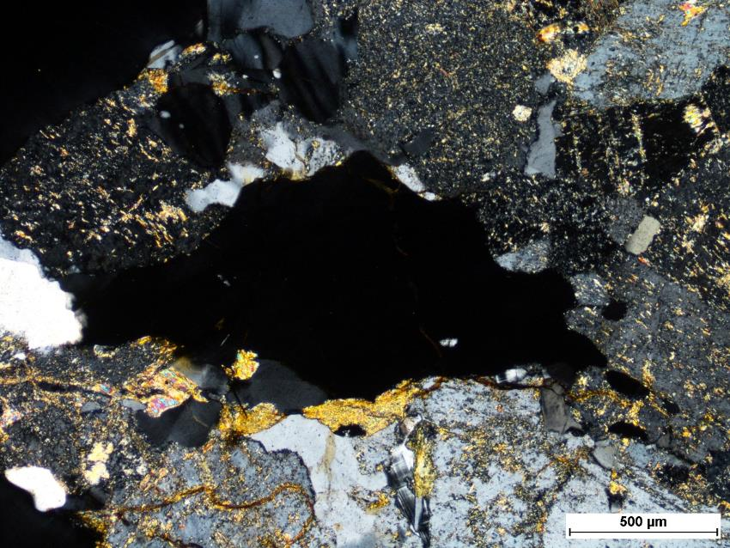
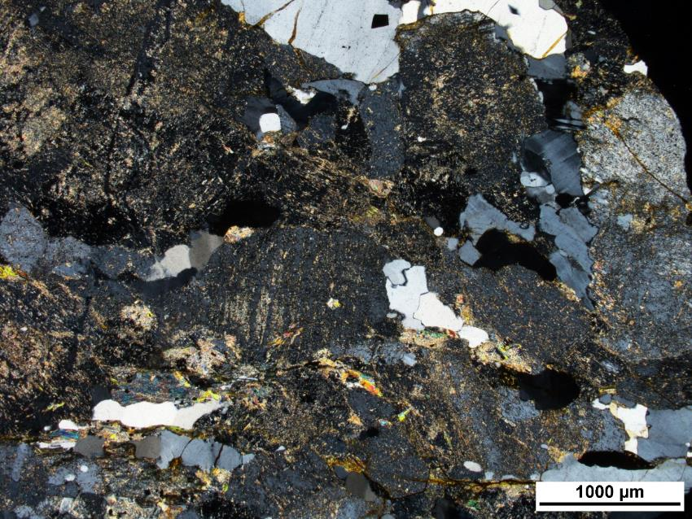

Slide 44
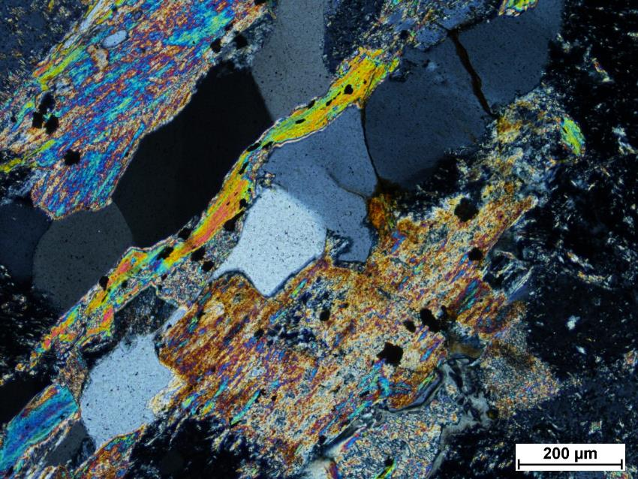
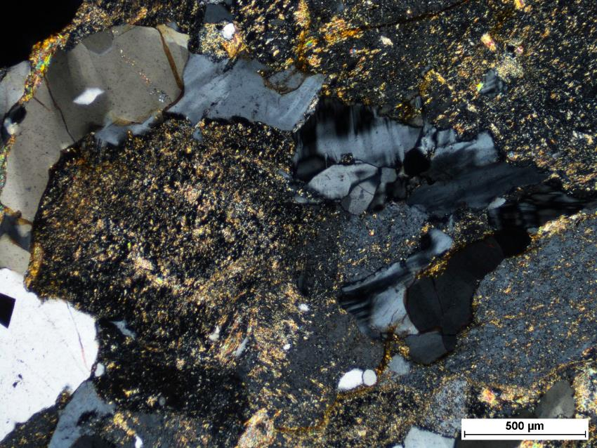

Slide 45
SS1-5

Slide 46
SEM minerals
Plagioclase, quartz, K-feldspar, muscovite, biotite, chlorite, apatite, zircon, iron oxide, monazite, thorite, rutile, pyrite, galena, gold-telluride

Slide 47
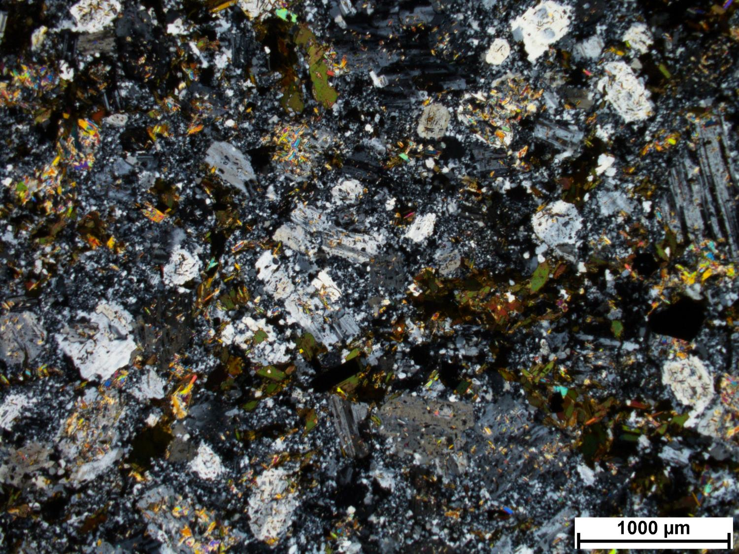
SS1-5
Notes:
Alteration consistent with CM.
Fine-grained alteration, possibly albite, K-feldspar, or quartz.
Magmatic plagioclase with corroded margins. Hydrothermal white mica replacing plagioclase, aligned with twinning.
Two generations of biotite. One magmatic and one hydrothermal. Lighter (phlogopitic) biotite replacing darker magmatic bitotite, then replaced by chlorite.
Primary Ti-bearing Bt altering to produce phlogopite and rutile.
Opaques associated with phlogopitic biotite.
Paragenesis: Plag + Bt, then hydrothermal Bt, white mica, rutile, opaques.
-Bt
-Ms
-Qtz-Pl-Kfs
Pl
Rt-
-(Au-Te-bearing) Py
Pl
Pl

Slide 48
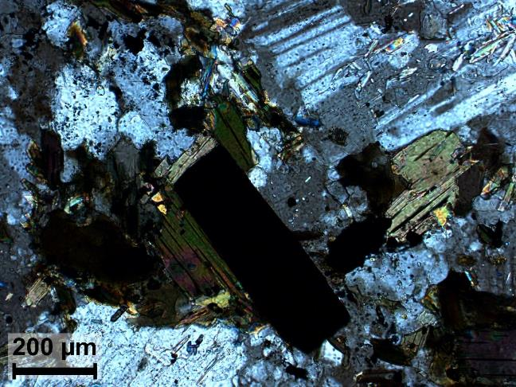
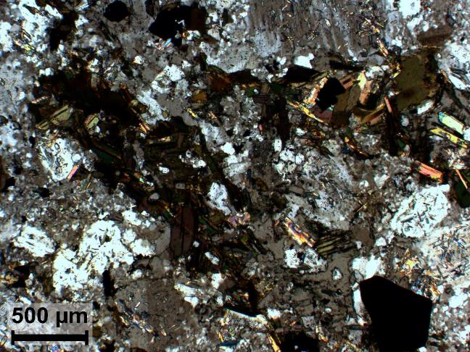

Slide 49
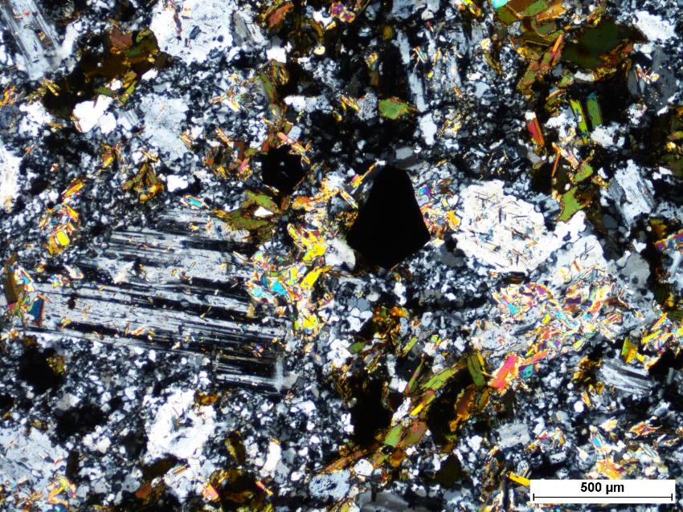
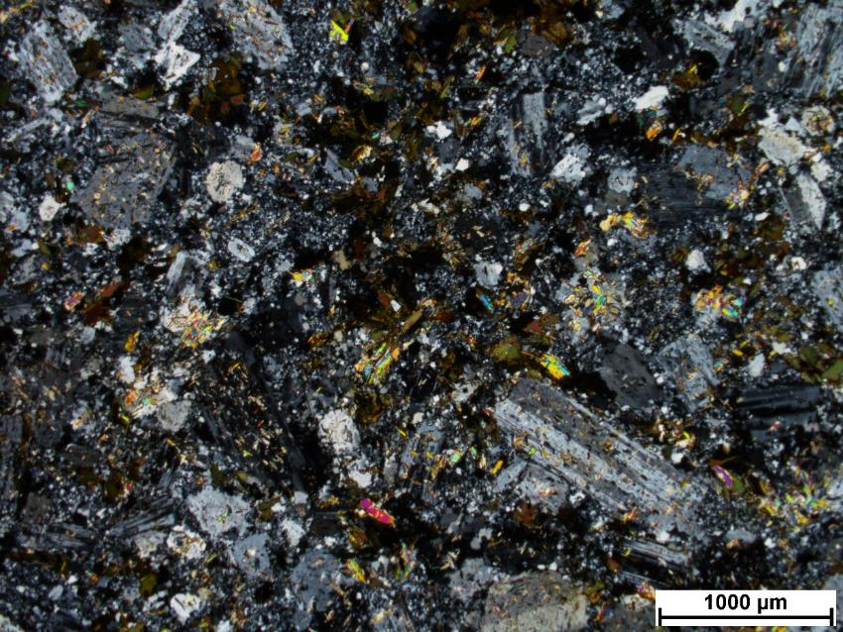

Slide 52
SS3-1

Slide 53
SEM minerals
Plagioclase, K-feldspar, muscovite, biotite, titanite, epidote, zircon, barite, rutile, allanite, pyrite, galena

Slide 54
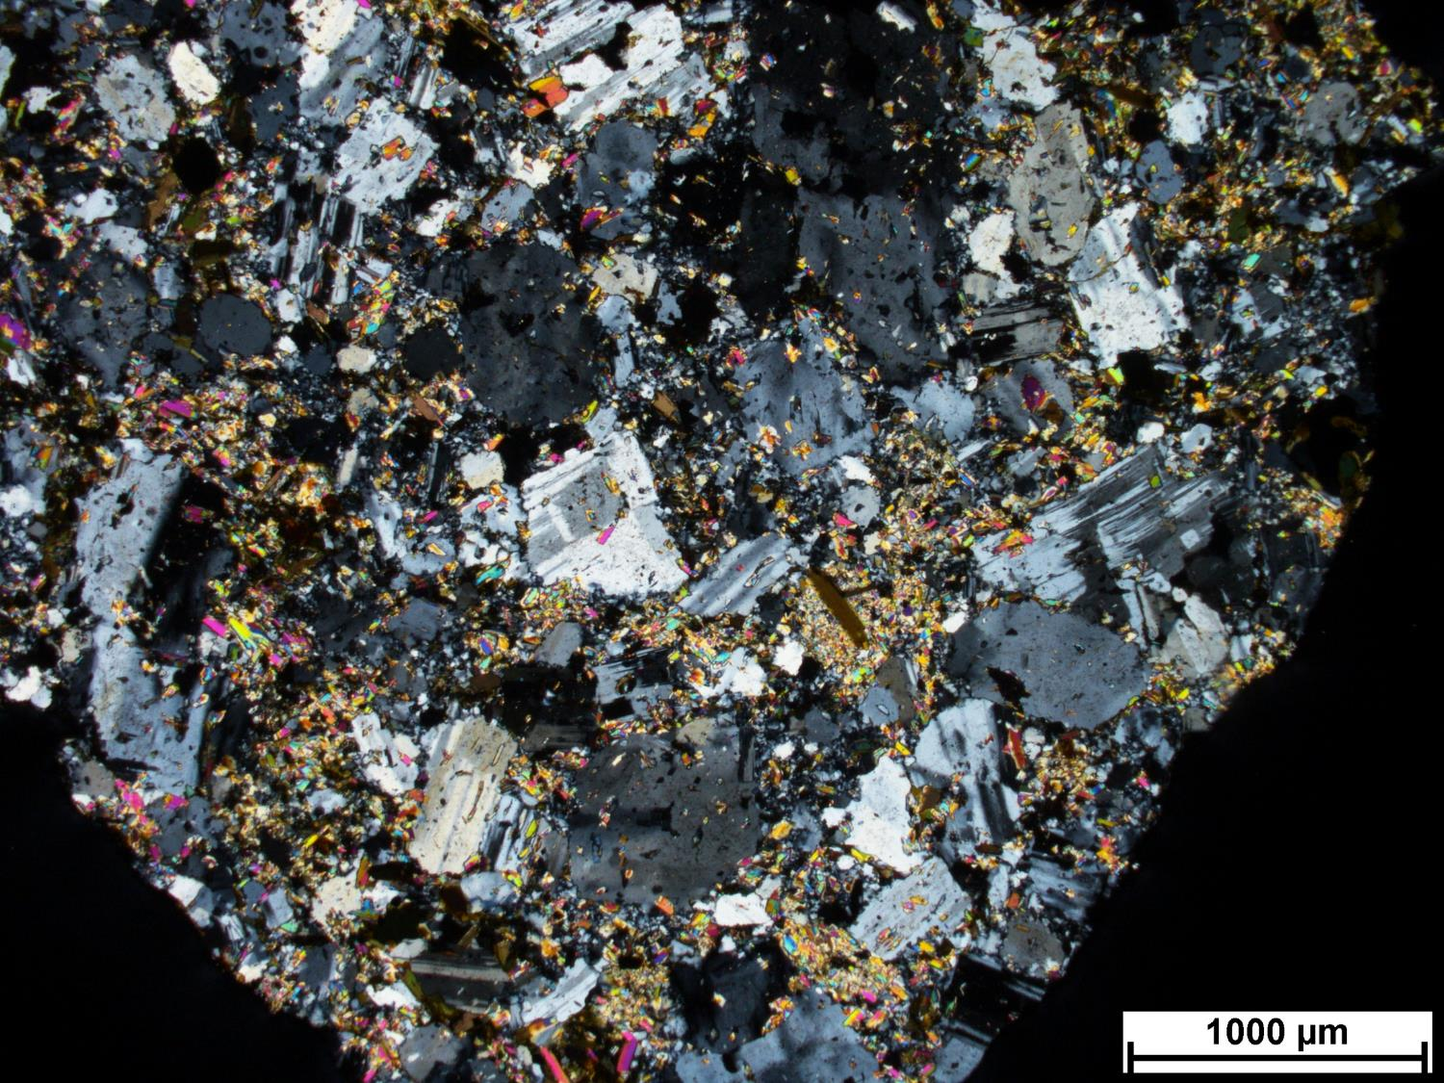
SS3-1
Notes:
Intrusive rock, porphyritic
WM alteration on plag with corroded margins
Complete replacement of some grains with fine WM and silica
Magmatic Bt replaced by WM, hydrothermal Bt
Opaques? Associated with rutile and hydrothermal Bt, qtz or plag?
Typical of CM
Py associated with Bt
Wm replace feldspar

Slide 55
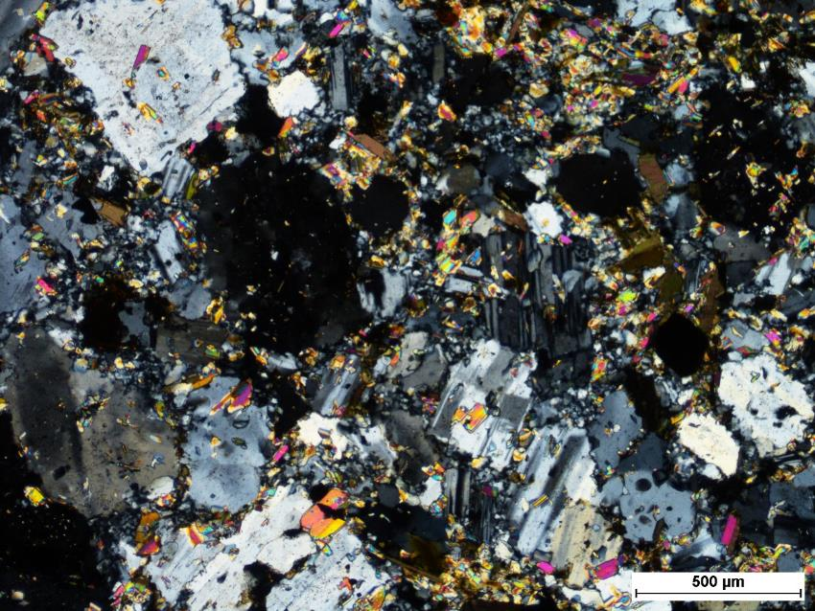
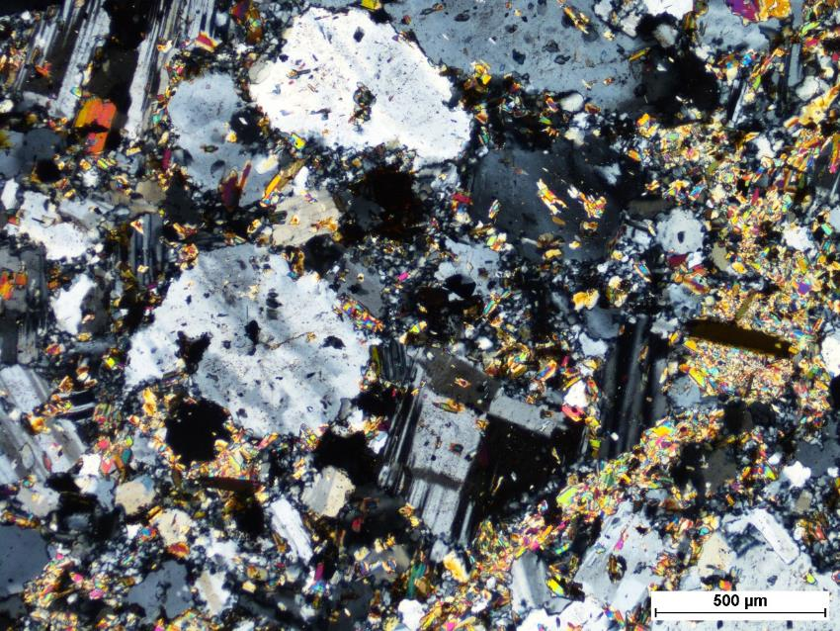

Slide 56
Barite

Slide 57
SS3-2

Slide 58
SEM minerals
Plagioclase, quartz, K-feldspar, muscovite, chlorite, titanite, apatite, zircon, iron oxide, thorite, rutile, allanite,

Slide 59
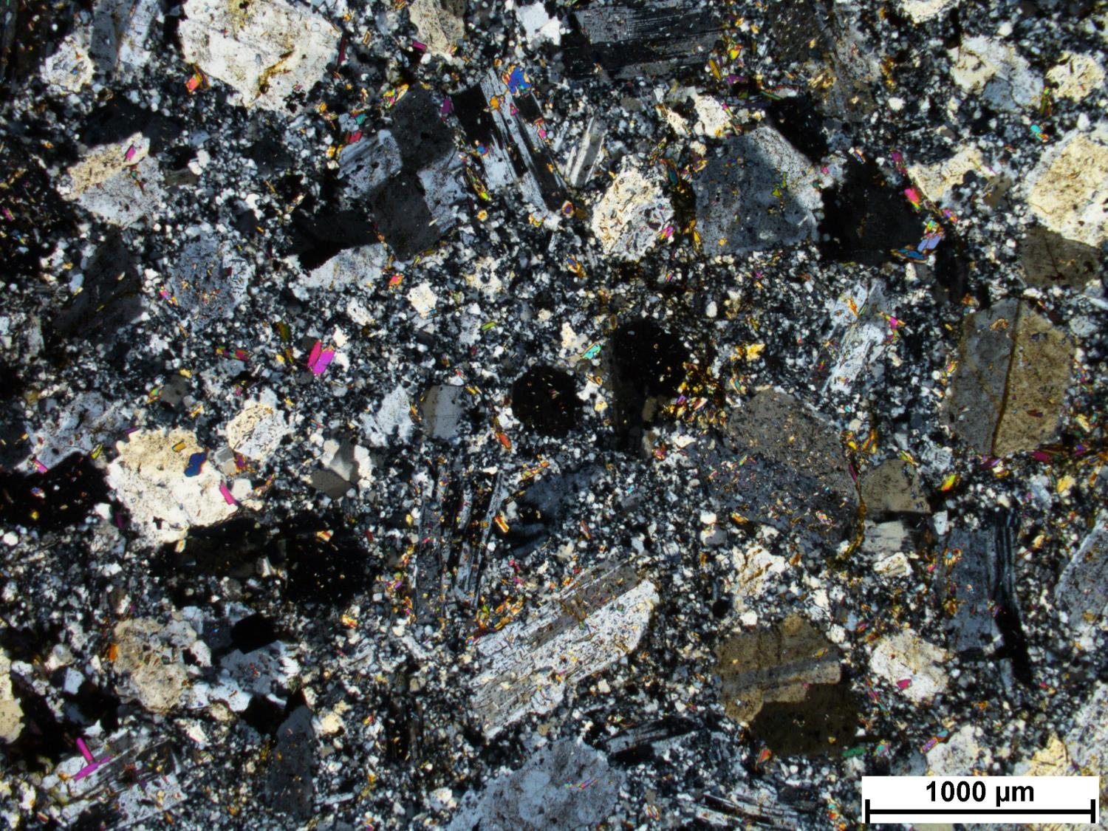
SS3-2
Notes:
Plag-rich porphyritic rock
Monzonite protolith
WM alteration of plag with corroded margins
Silicification of groundmass
WM on chlorite and rutile (that are replacing a mafic mineral?)
Pyrite with chlorite
Little bit of chlorite (retrograde at CM)

Slide 60
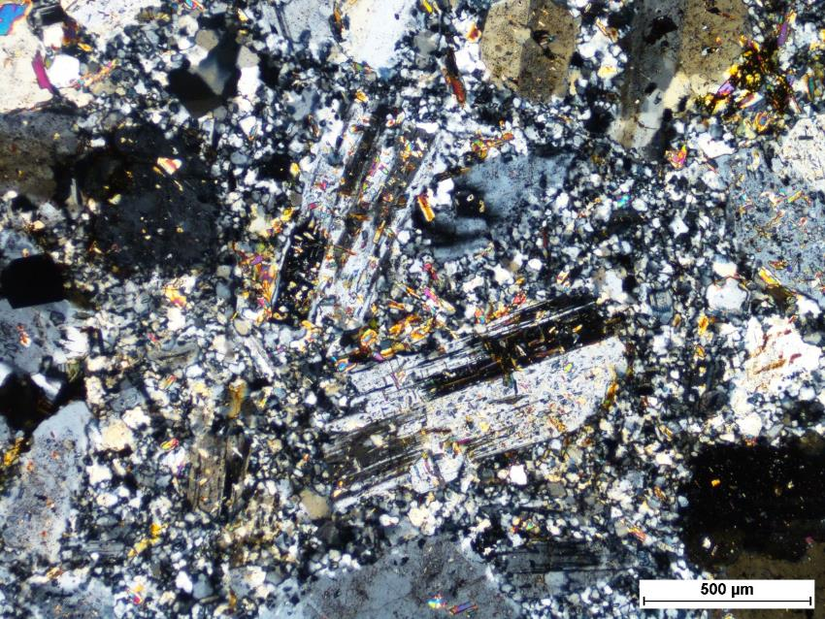


Slide 61
SS3-topright

Slide 62
SEM minerals
Plagioclase, quartz, K-feldspar, muscovite, biotite, chlorite, titanite, epidote, zircon, iron oxide, ilmenite, monazite, rutile

Slide 63

SS3-topright
Notes:
Porphyritic, monzonite (feldspar porphyry)
Magmatic Bt
Similar to SS3-
Lots of WM

Slide 64



Slide 65



Slide 66
SS49-4

Slide 67
SEM minerals
Plagioclase, quartz, K-feldspar, muscovite, apatite, zircon, iron oxide, monazite, rutile

Slide 68

SS49-4
Notes:

Slide 69



